Slide 1
COMM 1311-105
Written Communication
Assignment 3:
Descriptive Writing
Dr Dion C. Smythe
dsmythe@pmu.edu.sa
10th November, 2020

Slide 2
E-mails
Name, PMU ID#, course and section;
Subject of the e-mail;
Last week e-mailer was not instantaneous;
I answer e-mails as quickly as I can when I receive them;
I do not answer e-mails over the weekend;
[at least you cannot rely that I shall];
Writing on Thursday at 19:05 asking for a topic for deadline at 23:59 is stupid;

Slide 3
Grades for Assignment 2
Available on Blackboard;
There is feedback available on blackboard;
‘Stet’ means ‘it stands’; it is unchanged;
Do not e-mail me about your grade BEFORE you have read the feedback;
Feedback has 2 functions:
It reminds me why I give the grade I gave;
It shows you why you got the grade you did, and what you must do to get a better grade in the future;

Slide 4
Assignment 3: Descriptive
Assignment 3 is a [physical] descriptive piece;
You are to write a 500 word essay in 5 parts
That PHYSICALLY describes an object;
Intro; Body 1, Body 2, Body 3, Conclusion;
It MUST have a plan before the essay;
Due 19th November 2020 at 23:59;
I want to see ALL your drafts before submission;
Draft submission by Thursday 12 xi 20 @ 23:59

Slide 5
Description: Arlov, p.123
“You can’t miss it. It’s the big yellow house on the corner.”
“You can’t miss it. Turn right, just where the Thomases’ place used to be; it’s straight ahead.”
“Officer, he was bald with a tattoo of a turtle on top of his head.”
“I just asked to borrow a pen, and she gave me a look that would freeze hot coffee on a July day.”

Slide 6
Description: the senses
How many senses are there?

Slide 7
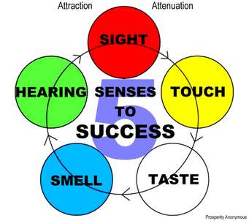
Description: the senses
How many senses are there?

Slide 8
Description: the senses
How many senses are there? Five (5) senses;
Sight; -- strong and immediate;
Smell; -- evocative, linked to memory;
Sound; -- sets a ‘tone’; ‘emotional’ appeal;
Touch; -- not always just what be do w/ hands
Taste; -- linked to food; used otherwise;
For physical descriptions, review each one;

Slide 9
Description: Arlov pp. 126-127
Importance of adjectives – descriptive words;
Peaceful; creaking; wooden; gauzy; scolds (a verb but a descriptive verb); sleepy drone; a light breeze wafts; tempting aroma; calico cat; warm patch of sunlight; warm furry body;
She rumbles her approval;

Slide 10
Arlov, pp 132-133
Juke Joint Description
‘rising laugh, like notes payed on a piano’
‘pungent haze of smoke’ – OK guess. NB ‘joint’;
A ‘jukebox’ [how quaint!] Spotify 50 years ago;
‘the clink of bottles’; ‘illegal liquor’ – liquid; hooch
‘Moon pies’ [oh my!]; a ‘cooler’ more usual here!
‘man with a goiter’; an old pew; parasol; Keds;
What helps create the impression of the exhibit?
How are words (what words) are used to make the description come alive?

Slide 11

Possible Description Piece

Slide 12
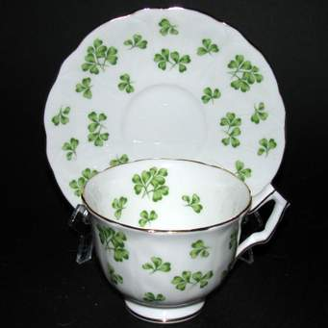
Possible Description Piece

Slide 13
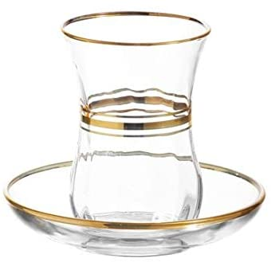
Possible Description Piece

Slide 14
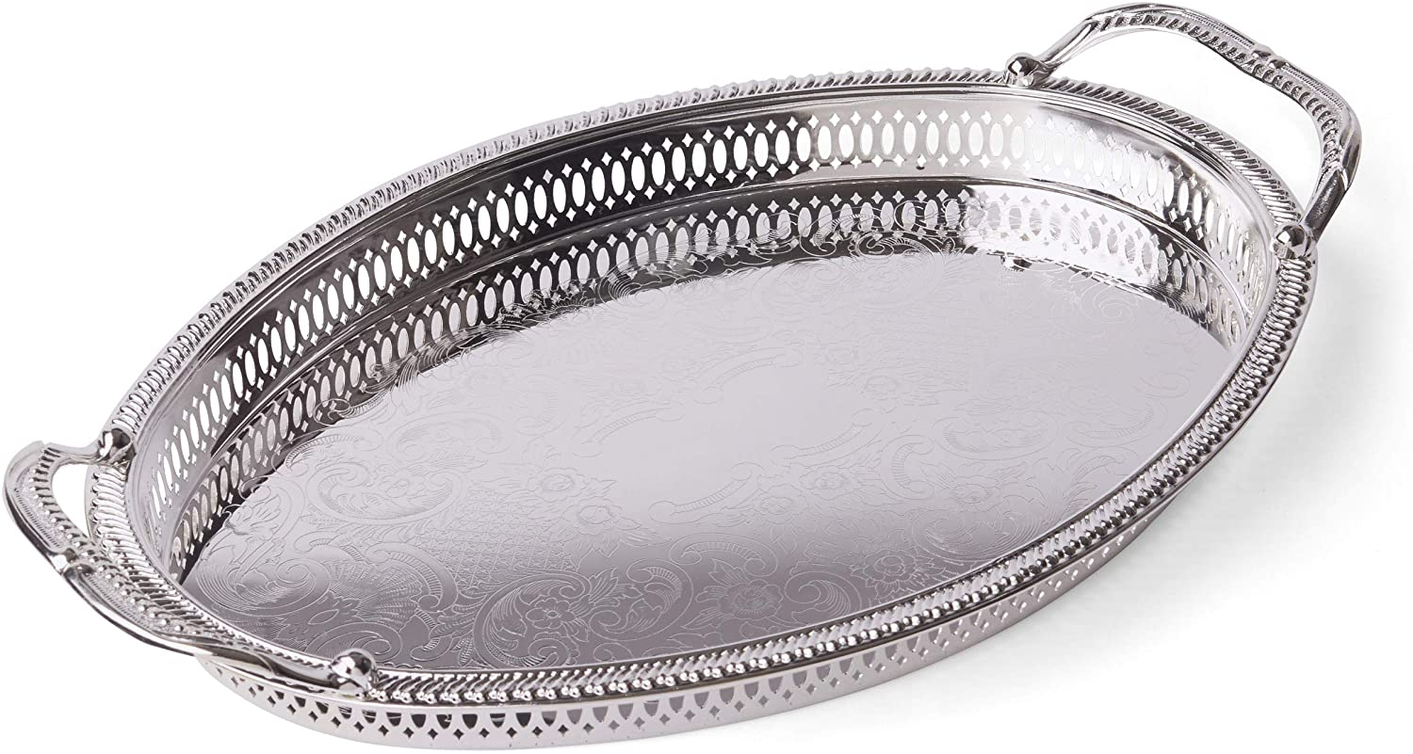
Possible Description Piece

Slide 15
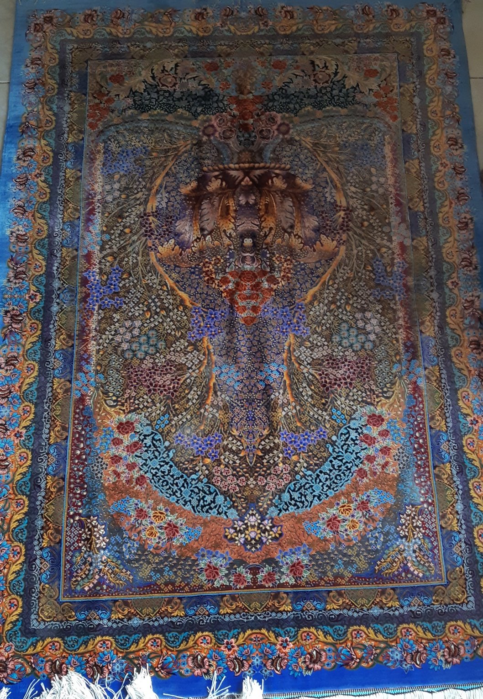
Possible Description Piece

Slide 16
Arlov, pp 134-135
Descriptive Topics
#1 describing a place; [Great Mosque; any mosque]
Word choice determines the topic sentence/sense;
Clean, majestic, homely, pleasant, uplifting, filthy, restorative, hectic, lively, isolated, dour [opposites]
Colours can be important but they do not make a dominant impression (even Blue Mosque Stamboul)
Size: scale; human; monumental; soaring; squat; minarets; round towers; broad; plaza; square; piazza
Think about the place with/without people, perhaps

Slide 17
Arlov, pp 134-135
Descriptive Topics
#2 a person: physical; NOT what they have done!
Greeks said: start at the crown of their heads and move down to their feet. Hair (colour thickness); eyes (colour brightness); nose; mouth; cheeks;
Arms, chest, waist, legs, feet, stance, athleticism;
His character: good points [evidence]; bad points [evidence] (how do we know?) what is dominant – links back to the topic sentence statement of first impressions [how quickly are 1st impressions made]

Slide 18
Arlov, pp 134-135
Descriptive Topics
#3 a Vacation in Paradise; your ideal spot/place-type
Details of the place – seaside, country, climate;
Where you would stay – luxury, roughing it, tents
What would you do/see: attractions or activities
If activities, what: done before or new? Learning?
Meeting new people? Understanding [about] them?
One place or touring around, travelling?
Alone, with friends, with family?

Slide 19
Arlov, pp 134-135
Descriptive Topics
#4 the cockroach – imaginative; putting yourself in someone else’s shoes – empathy or sympathy;
talking about each of the five senses (so you end up with a paragraph of at least five sentences as you write one sentence per sense).
how it moves? scuttles; dash, dart; scurry;
where? Crack, crevice, gap, breach, hole, skirting board;
Doing? Hunt, search, seek, find, devour, eat, nibble, gnaw,

Slide 20
Arlov, pp 134-135
Descriptive Topics
#5 Secret Shopper. Do they have secret shoppers in Saudi Arabia? In Al Khobar? What sort of shops (or retail outlets) do you frequent [go to]? Describe it.
Size: a shop, a kiosk, an on-line website?
Its real-time ambiance? What are the staff like? Old, young? A retail outlet undergoing ‘Saudisation’?
How do they greet customers? Do they greet you? Does it matter? How does it make you feel re store?
What about ‘the stuff’ – the merchandise? Is it easy to find? Is it fresh, clearly labelled? Priced? Haggle.

Slide 21
Assignment 3: Description
It must be a PHYSICAL description;
Do not use (a) your phone; (b) your car;
Something you know well; see every day;
Something small that you can lift; [easier];
Use specialised words for senses and so also adjectives for the ‘response’ to senses;
Pairs/Opposites: sweet/sour; light/dark; etc.

Slide 22
What is the topic of your descriptive piece of writing going to be?

